Slide 1
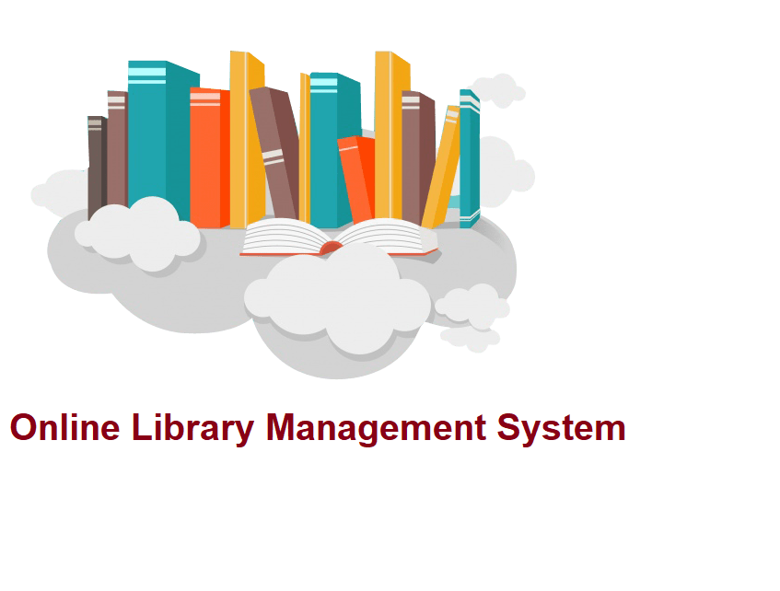

Slide 2
Introduction
To develop a project titled “Online Library Management System” and is to maintain the operation done in a library.
To ease the transactions done in library by computerizing the whole system.

Slide 3
Objective
The objective of this application is to design a system to maintain the information related to Library. The purpose is to perform operations and maintain a centralized repository of information about all activities regarding a library.

Slide 4
Proposed System
The project “Online Library Management System” mainly focuses on basic operations like login, registration, adding new member, adding new books, and updating new information, Searching books, issued book date and return date and facility to borrow and return books.
All transactions are computerized.
Less paper work.

Slide 5
System Requirements
Software Requirements
Front-End : Angular
Back-End : Spring Boot
Database : MongoDB

Slide 6
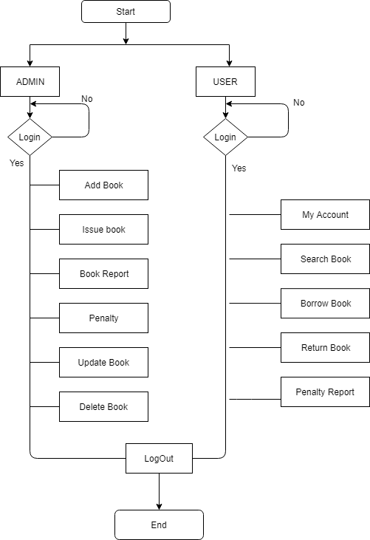
Flow chart

Slide 7
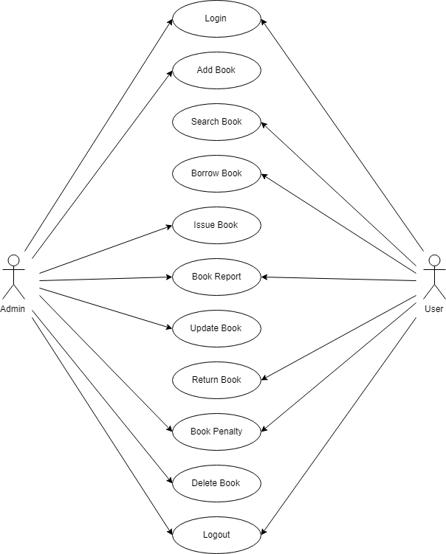
Use case diagram

Slide 8
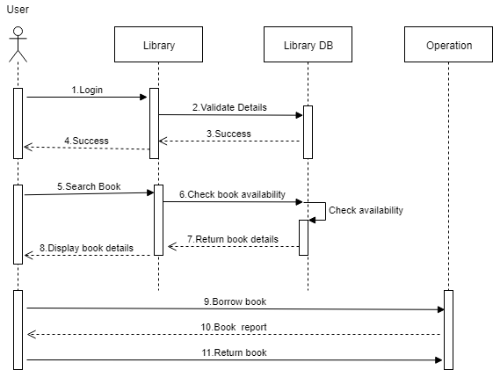
Sequence diagrams

Slide 9
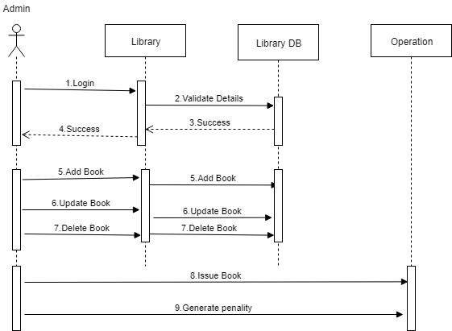

Slide 10
Student database
Serial No | Column Name | Data type | Length
1 | studentId | string | 20
2 | studentName | string | 20
3 | email | string | 10
4 | password | string | 50
5 | bookLimit | number | 10

Slide 11
Admin database
Serial No | Column Name | Datatype | Length
1 | Username | string | 20
2 | Password | string | 10

Slide 12
Books database
Serial No | Column Name | Datatype
1 | Book_id | string
2 | Book_name | string
3 | Author | string
4 | Rack_number | number
5 | noOfBooks | number
6 | bookUrl | string

Slide 13
Request database
Serial No | Column Name | Datatype
1 | transaction_id | number
2 | username | text
3 | issue_date | date
4 | due_date | date
5 | return_date | date
6 | penality | number

Slide 14
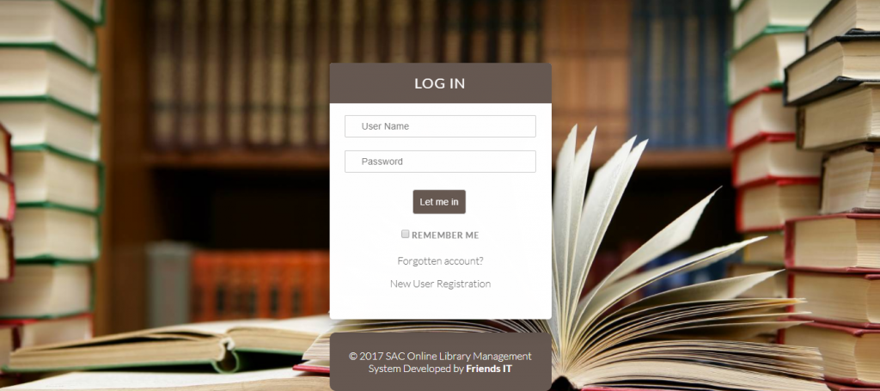
Sample screenshots

Slide 15
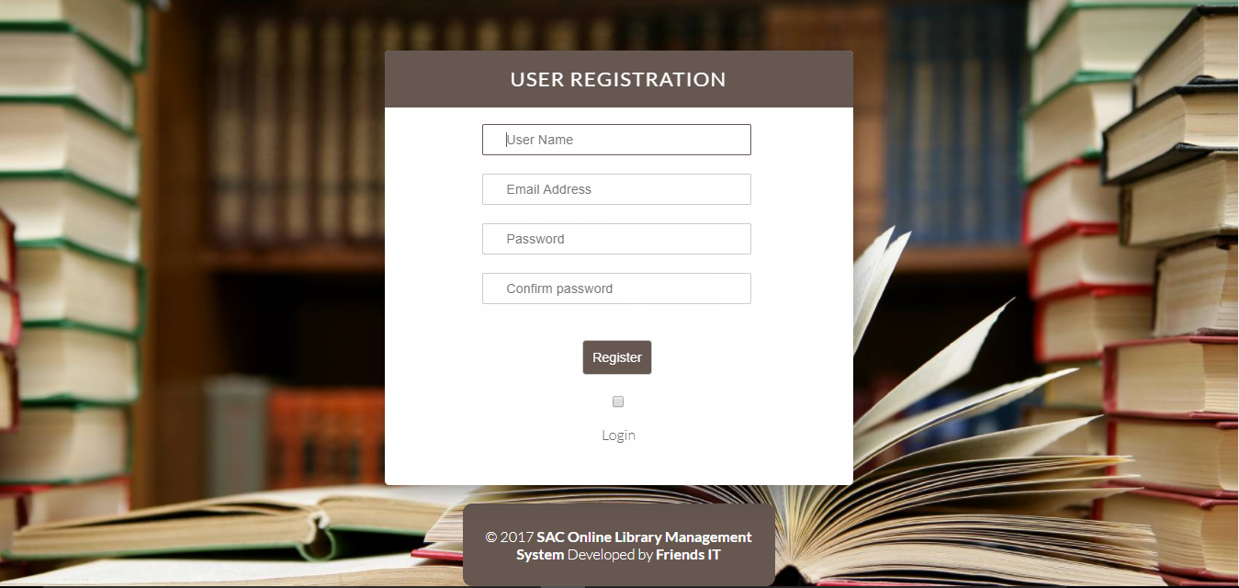

Slide 16
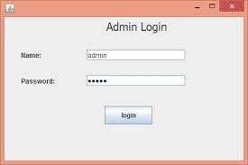
Admin Log in

Slide 17
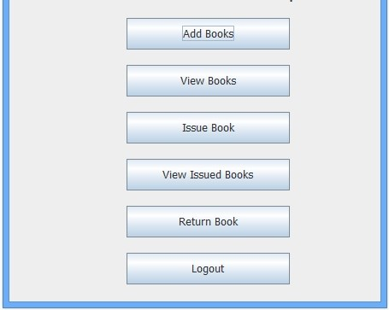
Admin operations

Slide 18


